Slide 1
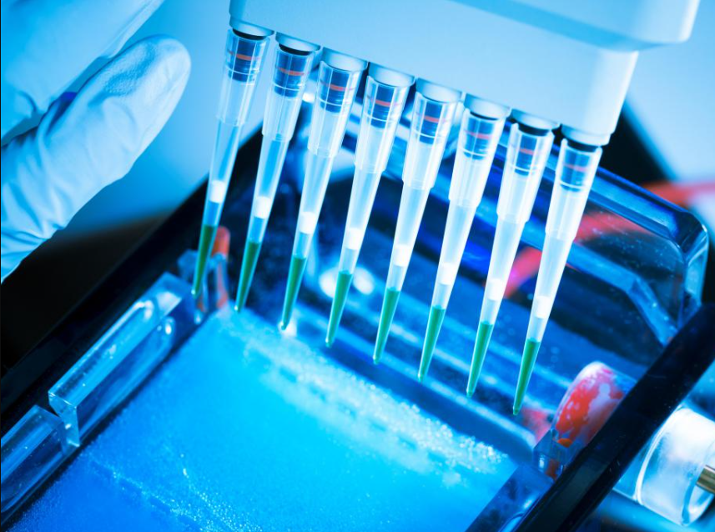
A Brief Explication of Electrophoresis
q
Introducing Electrophoresis
Apparatus
Procedure
Applications & Prospects
Name: Dipika Labonyo
ID No: 23607024

Slide 2
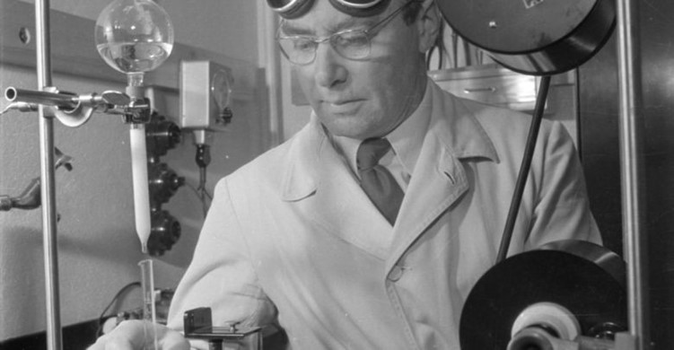
Introducing Electrophoresis
The migration of proteins & other
charged molecules in an electric
field passing through a solution.
Developed by ArneTiselius
who won the Nobel Prize in
1948.
Follows the principle of different
responses of each protein of a
protein mixture to an applied
electric potential.

Slide 3
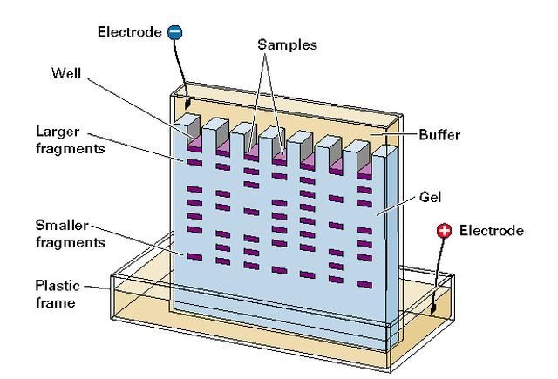
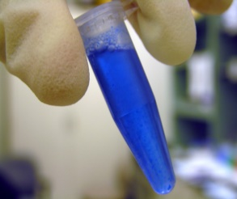
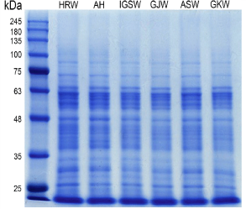
Equipment of Electrophoresis
Compartmented cells
forming U shaped tubes,
connected to an anode &
a cathode compartment.
U tube immersed in a water
bath at 4 degree.
Protein solution at the bottom
of U tube.
Chemicals such as polyacrylamide
gel, Sodium Dodecyl Sulfate,
Coomassie blue dye etc.

Slide 4
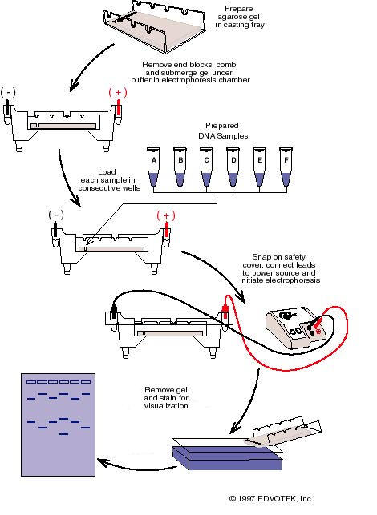

Methodology
Layering samples in the little slots at the top of the gel
Applying voltage after layering SDS buffer over the samples
Movement of the proteins into the gel
Obtaining result from staining the protein mixture
layered at the top of the gel

Slide 5
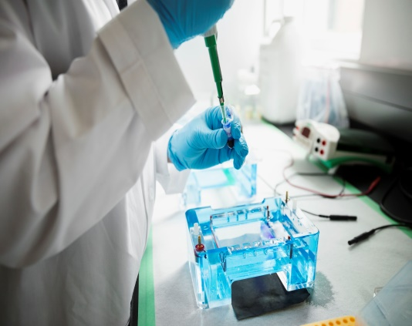
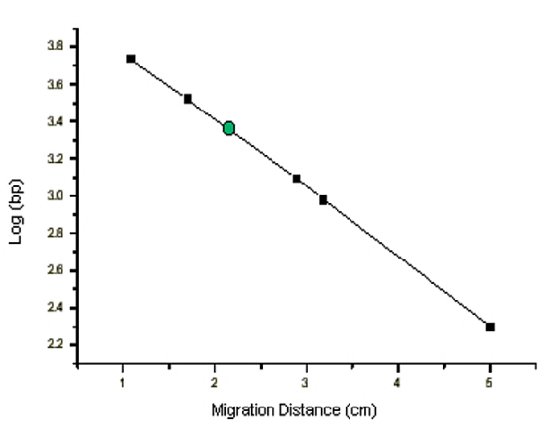
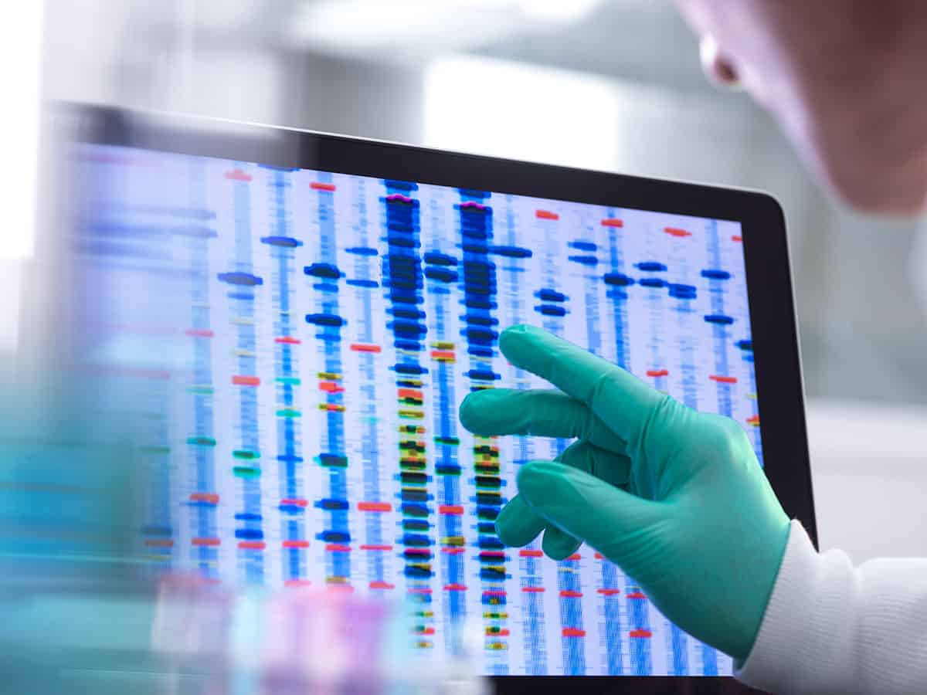
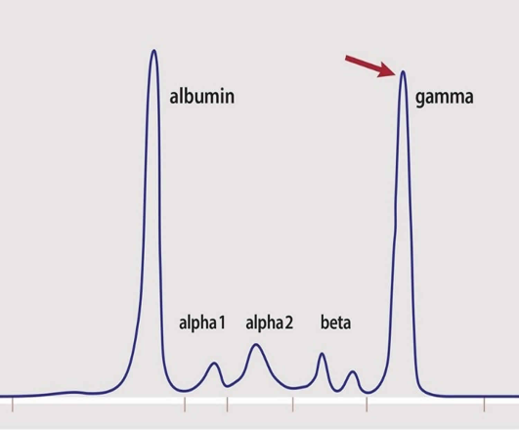
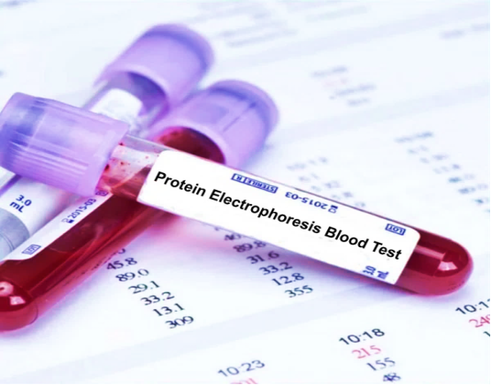
Applications & Prospects
Useful in estimating the number of proteins in a mixture or the degree of purity.
Determines the crucial properties of a protein.
Being used for drug discovery, forensic analysis.
Has the potential to make diagnostic tests faster and cheaper.

Slide 6

THANK YOU

